Slide 1
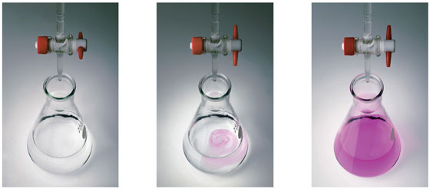
Volumetric analysis
Acid-base titrations

Slide 2
Titration Curve
What happens if I have a conical containing an acid and I very slowly add base to it?
As you add the base it will react with the acid to form water, so the concentration of acid is decreasing (so pH is increasing). If keep adding there will be a point when all the acid has reacted. Keep adding and the concentration of base will start increasing.

Slide 3
Titration Curve
Can you draw a rough graph of pH (y-axis) vs volume of base added (x-axis)?
Start with acid in the flask – if you know the concentration you can calculate the starting pH (using pH = - log[H⁺])
As add base the pH increases
The big change in pH occurs at point where all the acid has reacted – we call this the equivalency point

Slide 4
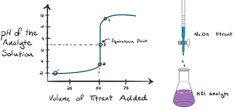
Titration
Is used to determine the concentration of an unknown acid or base
The titration is complete when the equivalence point is reached
We can use a pH meter to track the position of the reaction, or we can use an indicator

Slide 5
Equivalence point
Is when the acid and the base have been mixed in the proportions equal to their stoichiometric ratio for the reaction.
This will complete the reaction, neither reagent is in excess.
HCl(aq) + NaOH(aq) NaCl(aq) + H₂O(l)
( 0.1 mol L⁻¹)
( 0.1 mol L⁻¹)
20.00 mL
For this reaction, the equivalence point will be reached when the volume of NaOH titrated equals------- ?
--------20.00 mL
The moles of NaOH and HCl, mixed, are equal to the stoichiometric ratio for
the reaction……
1 : 1

Slide 6
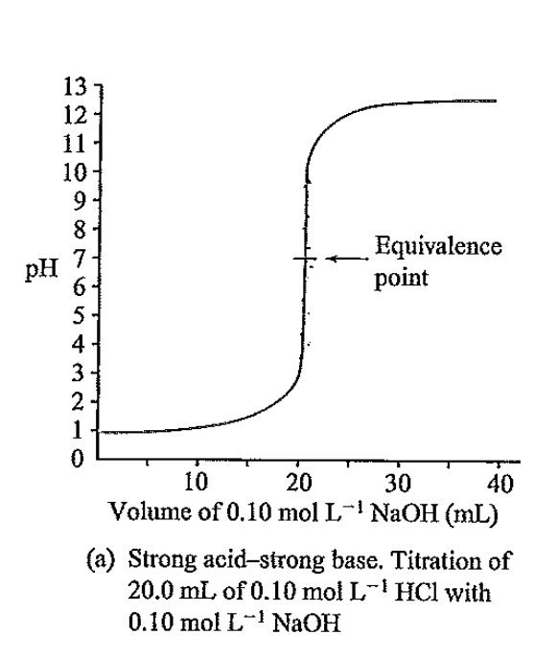
Equivalence point
pH is 7 at the equivalence point.
Why 7????
HCl(aq) + NaOH(aq) NaCl(aq) + H₂O(l)
H⁺_{(aq)}+ Cl⁻_{(aq)} + Na_{(aq)} + OH⁻_{(aq)} Na⁺_{(aq)}+ Cl⁻_{(aq)} + H₂O_{(l)}
neutral
All the products are…..

Slide 7
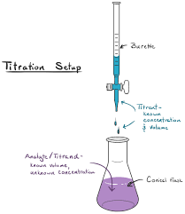
Equivalence point
What about this reaction?
What volume of HCl will need to be added to reach the equivalence point……………..?
If you said
40 mL
then go to the top of the class.
(1 : 2) mol ratio
Na₂CO_{3(aq)} + 2HCl _{(aq)} 2NaCl _{(aq)} + CO_{2 (g)} + H₂O _{(l)}
0.1 mol L⁻¹
20 mL
0.1 mol L⁻¹
x mL
pH at the equivalence point………?

Slide 8
Equivalence point
Na₂CO_{3(aq)} + 2HCl _{(aq)} 2NaCl _{(aq)} + CO_{2 (g)} + H₂O _{(l)}
3.8
pH at the equivalence point………?
It’s not due to an excess of HCl
It’s the equivalence point, the reactants are present in the correct 1:2 mol ratio
Slightly soluble in water.
Forms a weak acid.
There must be an acidic product
neutral
neutral
H₂CO_{3(aq)}

Slide 9
Hydrolysis
The hydrolysis reaction, of the carbon dioxide produced by the reaction, is responsible for the acidic equivalence point, in this titration.
e.g. CO_{2(aq)} + H₂O_{(l)} H₂CO_{3 (aq)} H⁺_{(aq)} + HCO₃⁻ _{(aq)}

Slide 10
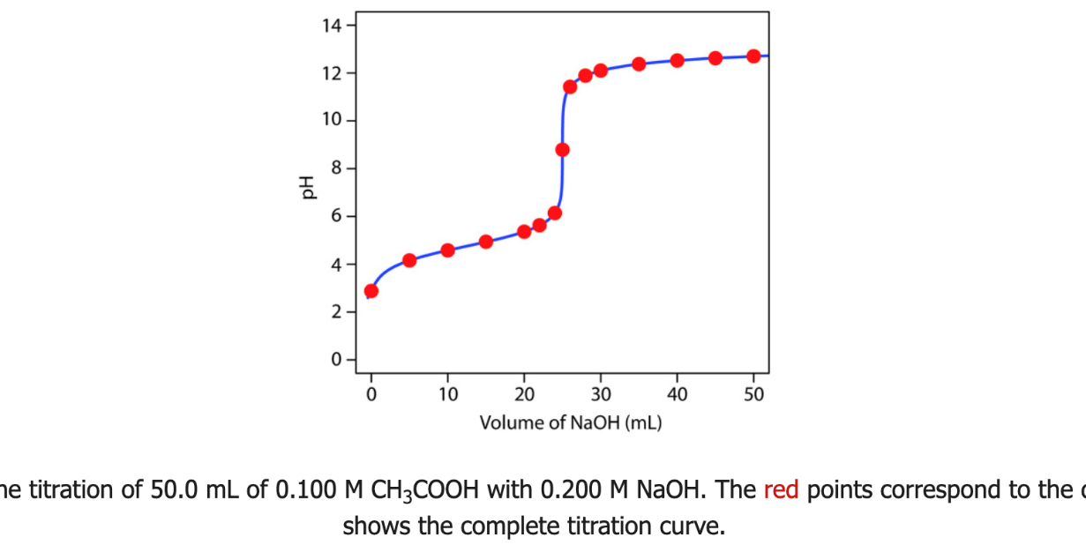
Weak Acid- Strong Base
alkaline equivalence pt
one of the products is a weak base
CH₃COOH_{(aq)} v NaOH_{(aq)}
CH₃COO⁻_{(aq)} + Na⁺_{(aq)} + H₂O_{(l)}
weak base
CH₃COO⁻ is the conjugate base of the weak acid…
CH₃COOH
Hydrolysis reaction of
ethanoate ion in water:
CH₃COO⁻ + H₂O
CH₃COOH + OH⁻

Slide 11
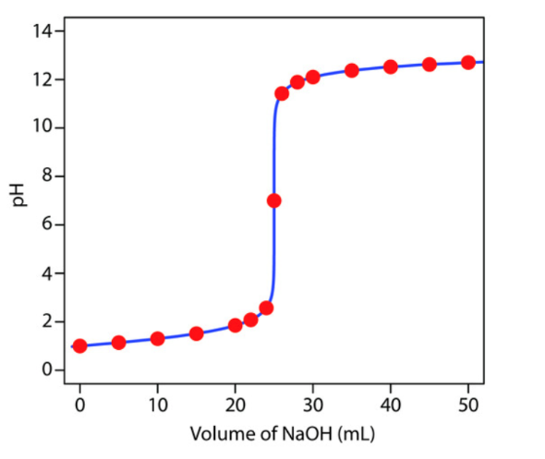
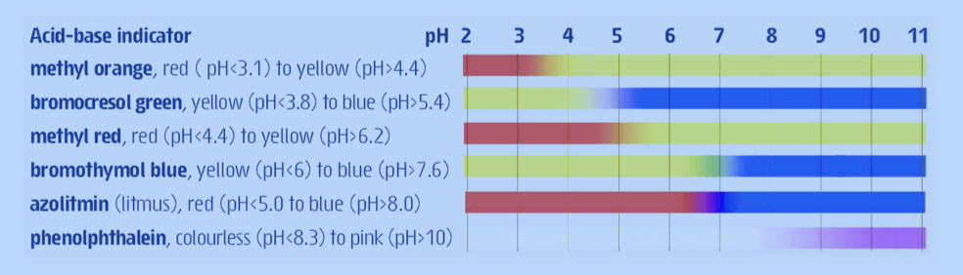
End Point
Is when the indicator changes colour
Equivalence point
Methyl orange
(3.1-4.4)
Methyl red
(4.4- 6.2)
A few drops of HCl near the equivalence point will change the pH from about 3 to 10
phenolphthalein
(8.3 - 10.0)
Any of the indicators above will be suitable

Slide 12
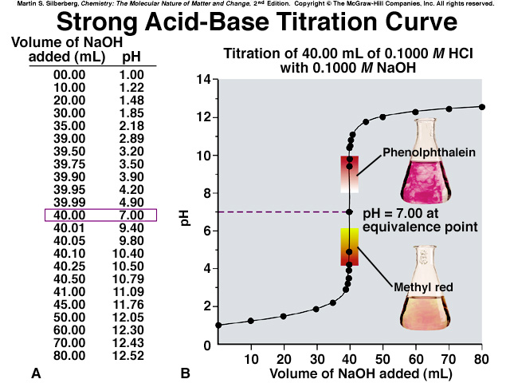

Slide 13
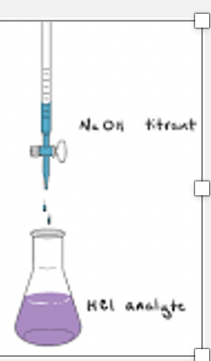
We’ll calculate the pH, when 30 mL of NaOH has been titrated
First use (n = cV), to calculate the mol of OH⁻ added in
the titration
n(OH⁻) = n(NaOH) = cV = 0.1 x 30 x 10⁻³ = 3.00 x 10⁻³ mol
Find the mol of H+ initially in the conical flask
n(H⁺) = n(HCl) = cV = 0.1 x 40 x 10⁻³ = 4.00 x 10⁻³ mol
Work out n(H⁺) that are excess
n(H⁺)excess = (4.00 x 10⁻³ )- (3.00 x 10⁻³ )= 1.00 x 10⁻³ mol
Then use c = n/V to calculate c(H⁺)
c(H⁺) = n/V = 1.00 x 10⁻³ /( 40+ 30)x 10⁻³ = 0.0143 mol L⁻¹
Volume of NaOH titrated
pH = -log(H+) = -log(0.0143) = 1.86

Slide 14
Features of the Strong Acid-Strong Base Titration Curve
The pH starts out low, reflecting the high [H₃O⁺] of the strong acid and increases gradually as acid is neutralized by the added base.
Suddenly the pH rises steeply. This occurs in the immediate vicinity of the equivalence point. For this type of titration the pH is 7.0 at the equivalence point.
Note the rapid change of pH at the equivalence point during dropwise addition of base
Beyond this steep portion, the pH increases more slowly as more base is added.

Slide 15
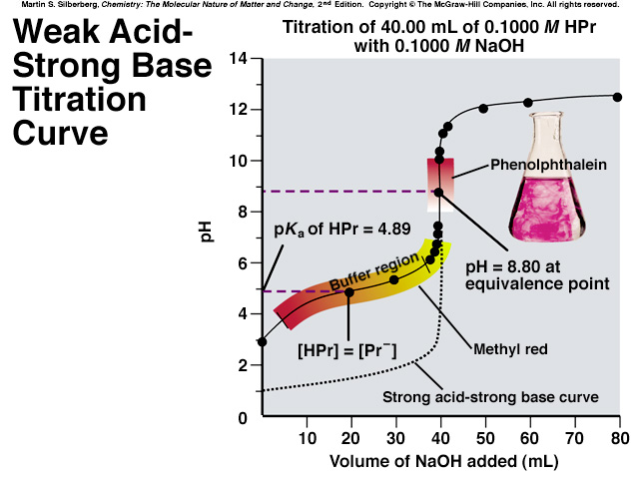
Note the basic equivalence point as the conjugate base (Pr⁻) hydrolyses in water:
Pr ⁻ + H₂0 = HPr + OH⁻
(HPr = Propionic Acid)

Slide 16
Features of the WEAK Acid-Strong Base Titration Curve
The initial pH is higher due to the partial ionisation of the weak acid.
A gradually rising portion of the curve, called the buffer region, appears before the steep rise to the equivalence point. This is where the weak acid and its conjugate base both appear in aqueous solution.
The pH at the equivalence point is greater than 7.00. This is due to the product of the titration, the conjugate base, hydrolysing in water to produce OH⁻ ions.
The steep rise interval is less pronounced in the weak acid titration.

Slide 17
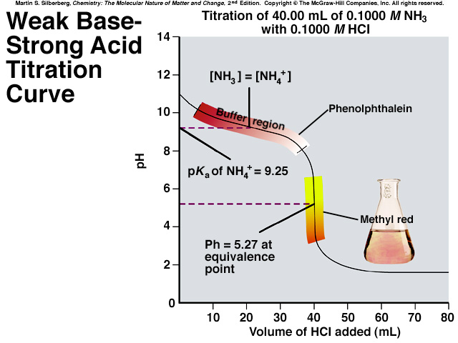
Note the acidic equivalence point as the conjugate acid (NH₄⁺) hydrolyses in water:
NH₄⁺ + H₂0 = NH₃ + H₃O⁺

Slide 18
Features of the Strong Acid-weak Base Titration Curve
The initial pH is lower due to the partial dissociation of the weak base.
A gradually decreasing portion of the curve, called the buffer region, appears before a steep fall to the equivalence point. This is where the weak base and its conjugate acid both appear in aqueous solution.
The pH at the equivalence point is less than 7.00. This is due to the conjugate acid (NH₄⁺) hydrolysing in water.
Thereafter, the pH decreases slowly as excess strong acid is added.

Slide 19
End point
Review point – the indicator needs to change colour within the vertical part of the titration curve. If you use an indicator that changes colour in the buffer region you will under or overestimate the concentration.
Why we use a range of different indicators to suit different systems

Slide 20
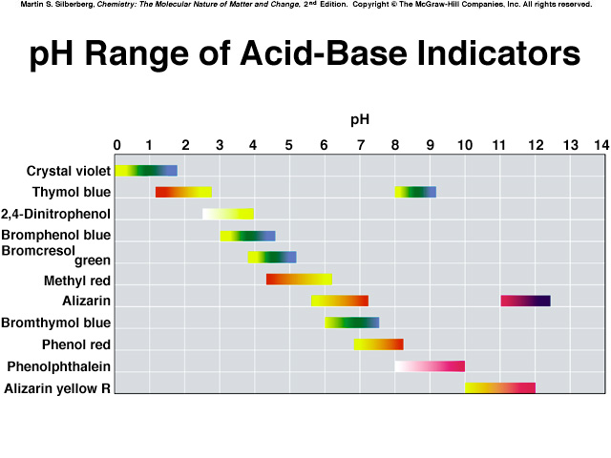
Just remember: methyl orange (for SA/WB pH~4)
and Phenolphthalein (WB/SA pH~9) and either for SA/SB

Slide 21
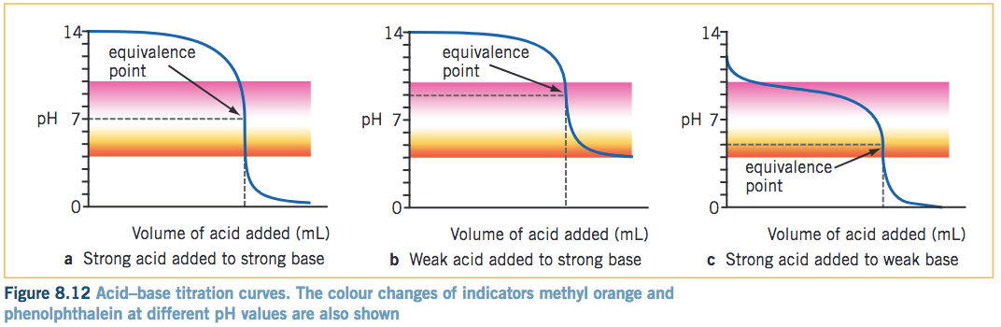
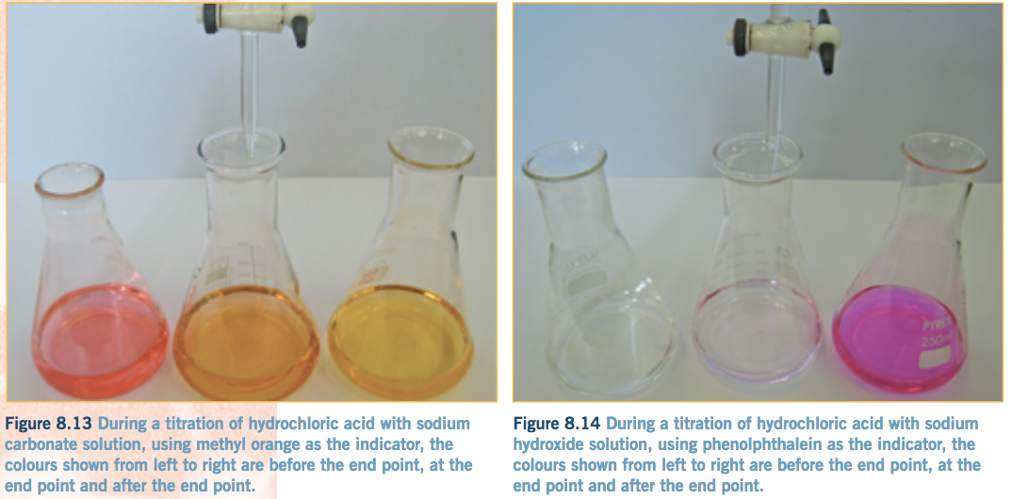
End point

Slide 22
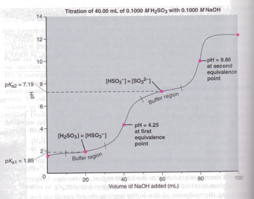
extension
Titrations involving weak acid and weak base are more complicated because of the hydrolysis of both cation and the anion of the salt formed. They rarely have a clear vertical section and need special attention. Not in Year 12 Chemistry.
Titrations involving polyprotic acids will have several endpoints and is shown below just for interest. Not in Year 12 Chemistry.

